Slide 1
Dimension Reduction Methods

Slide 2
statistical methods that provide information about point scatters in multivariate space
“factor analytic methods”
  simplify complex relationships between cases and/or variables
  make it easier to recognize patterns

Slide 3
how (and why)?
identify and describe ‘dimensions’ that underlie the input data
  may be more fundamental than those directly measured, and yet hidden from view
reduce the dimensionality of the research problem
  benefit = simplification; reduce number of variables you have to worry about
identifying sets of variables with similar “behaviour”

Slide 4
basic ideas
imagine a point scatter in multivariate space:
  the specific values of the numbers used to describe the variables don’t matter
  we can do anything we want to the numbers, provided we don’t distort the spatial relationships that exist among cases
some kinds of manipulations help us think about the shape of the scatter in more productive ways

Slide 5
imagine a two dimensional scatter of points that show a high degree of correlation …
y
orthogonal regression…
bar-y
x
bar-x

Slide 7
y
x

Slide 8
why bother?
more “efficient” description
  1st var. captures max. variance
  2nd var. captures the max. amount of residual variance, at right angles (orthogonal) to the first
the 1st var. may capture so much of the information content in the original data set that we can ignore the remaining axis

Slide 9
other advantages…
you can score original cases (and variables) in new space, and plot them…
spatial arrangements may reveal relationships that were hidden in higher dimension space
may reveal subsets of variables based on correlations with new axes…

Slide 10
width
length

Slide 11
“shape”
“size”

Slide 12
RITUAL
Ritual
candelero
Cooking
Service
Storage / Cooking
DOMESTIC
PUBLIC
PRIVATE

Slide 13
Principal Components Analysis (PCA)
why:
  clarify relationships among variables
  clarify relationships among cases
when:
  significant correlations exist among variables
how:
  define new axes (components)
  examine correlation between axes and variables
  find scores of cases on new axes

Slide 14
r = 0
r = -1
r = 1
x₁
x₂
component loading
pc₁
eigenvalue: sum of all squared loadings on one component
pc₂
x₃
x₄

Slide 15
eigenvalues
the sum of all eigenvalues = 100% of variance in original data
proportion accounted for by each eigenvalue = ev/n (n = # of vars.)
correlation matrix; variance in each variable = 1
  if an eigenvalue < 1, it explains less variance than one of the original variables
  but .7 may be a better threshold…
‘scree plots’ – show trade-off between loss of information, and simplification

Slide 16


Slide 17
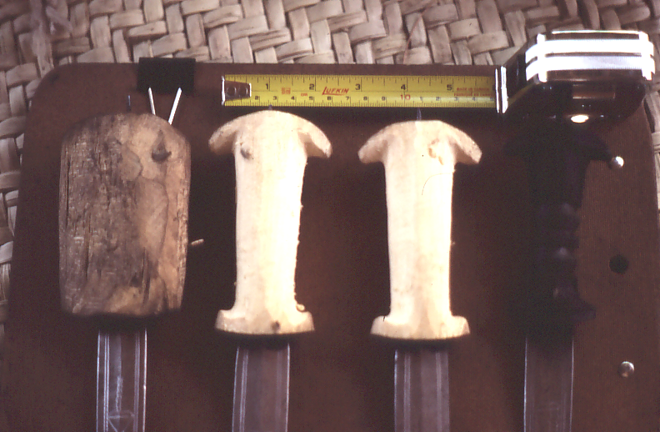
Mandara Region knife morphology

Slide 18
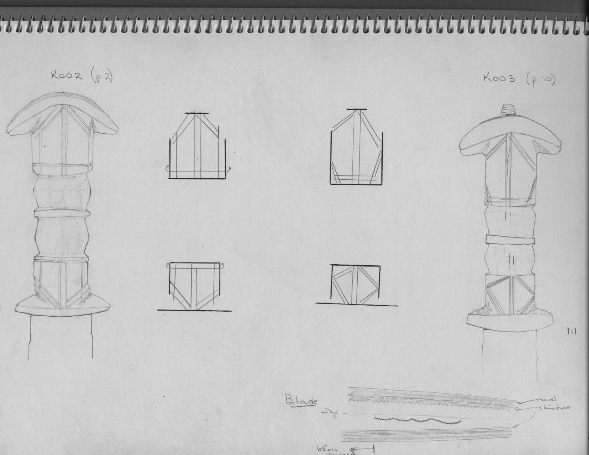

Slide 19
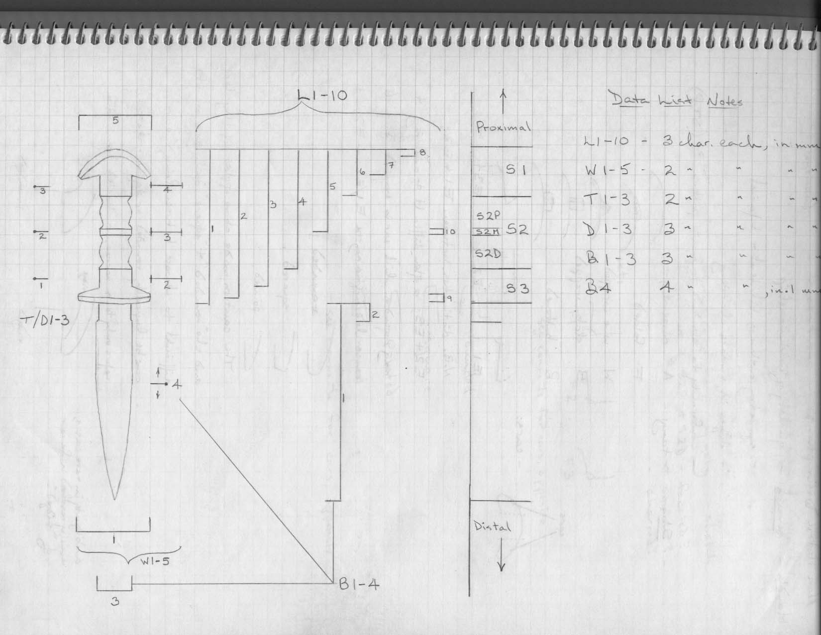

Slide 20
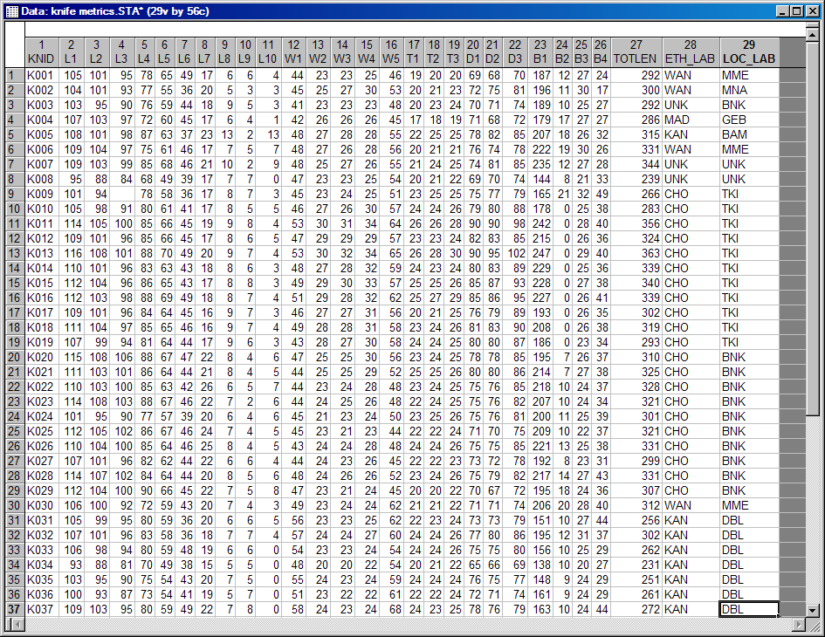
R

